Slide 1
NEW PROJECT

Slide 2
I NEED YOU TO HELP ME WITH A
SPECIAL PROJECT.

Slide 3
YOUR JOB IS TO RECREATE
AN IMMIGRANT NEIGHBOURHOOD.
You will be making an interactive map of 1940s Powell Street in Vancouver.

Slide 4
Each of you will "adopt“ a Japanese Canadian family, recreate their business and home, and place that property on the bulletin board map in our classroom.

Slide 5
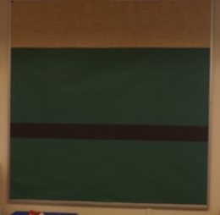
YOU WILL BE MAKING A DISPLAY OF AN IMMIGRANT, CITY COMMUNITY FROM OVER 70 YEARS AGO.
It does not look like much now…

Slide 6
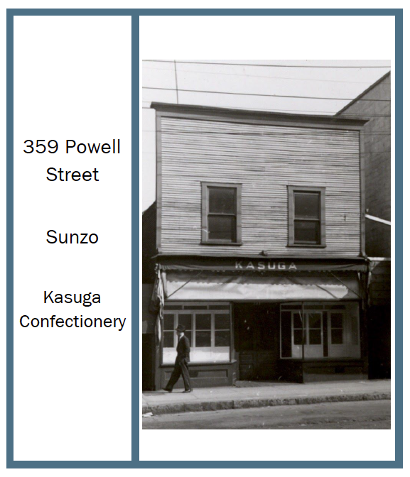
YOU WILL BE GIVEN A PROPERTY CARD.
It will include:
a picture of your property.
the address (so you will know where to put it on the map).
the name of the family who owned it.
the kind of business it was.

Slide 7
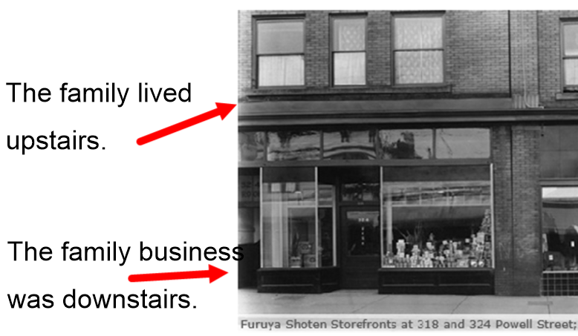

Slide 8
INDIVIDUALLY, EACH OF YOU WILL CREATE A BUSINESS DOWN BELOW WITH A PLACE TO LIVE (AN APARTMENT) UP TOP.
Each of you will use a card to make a business below and a residence up top.
Each card will be folded so that the outside of the card is the outside of the building, and the inside of the card is the inside of the building.

Slide 9
A FEW THINGS TO REMEMBER...
Make the rooms only (no people and no possessions yet).
Make the cards fit:
  the times: 70 years ago, there was electricity, but no computers, etc.
  the businesses: a counter and shelves for stores, etc.

Slide 10
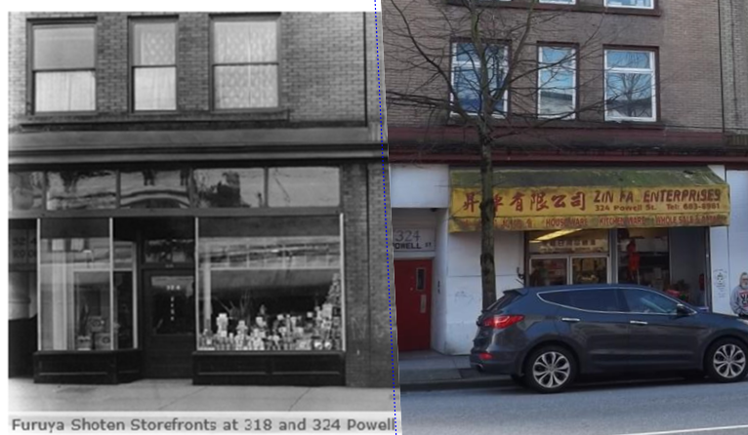
HERE IS WHAT ONE OF THE PROPERTIES LOOKED LIKE IN 1925 AND IN 2016.

Slide 11
END.
Show Property Cards and take questions.

Slide 12
PART 2: For TEACHERS ONLY
This next part shows samples of what our test teachers came up with in the simulations.

Slide 13
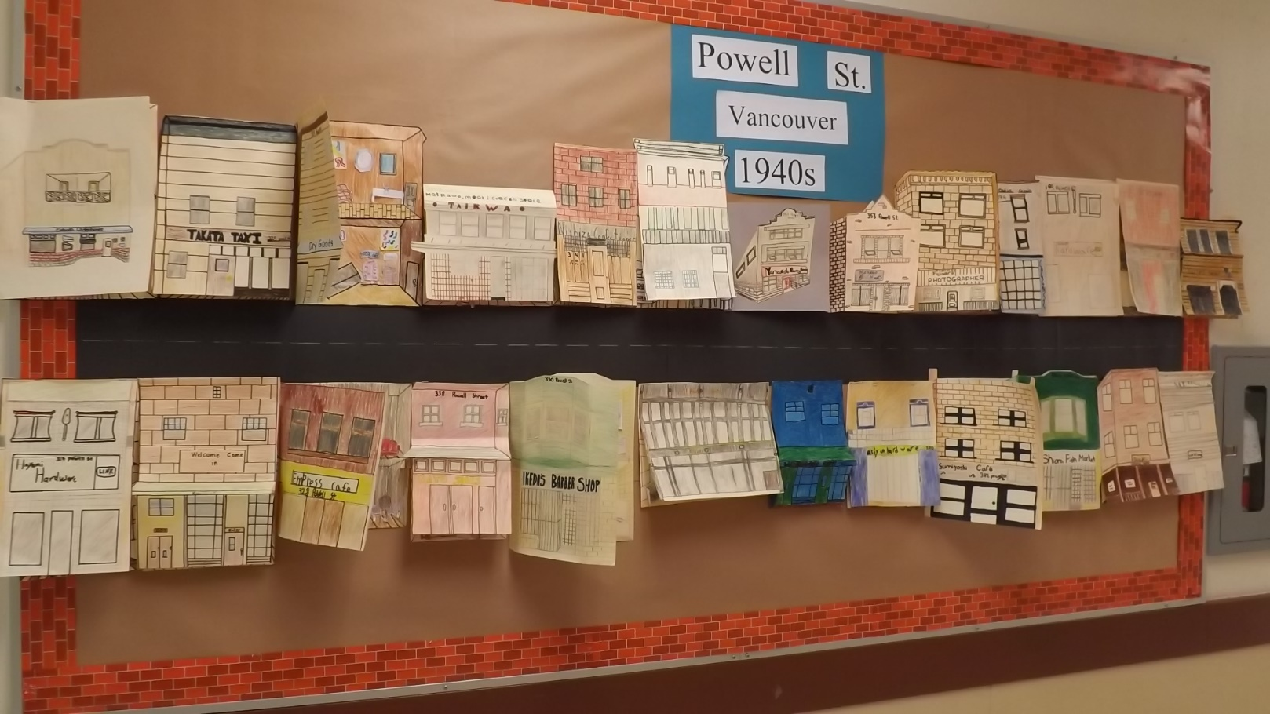
LINDSAY’S POWELL STREET SIMULATION

Slide 14
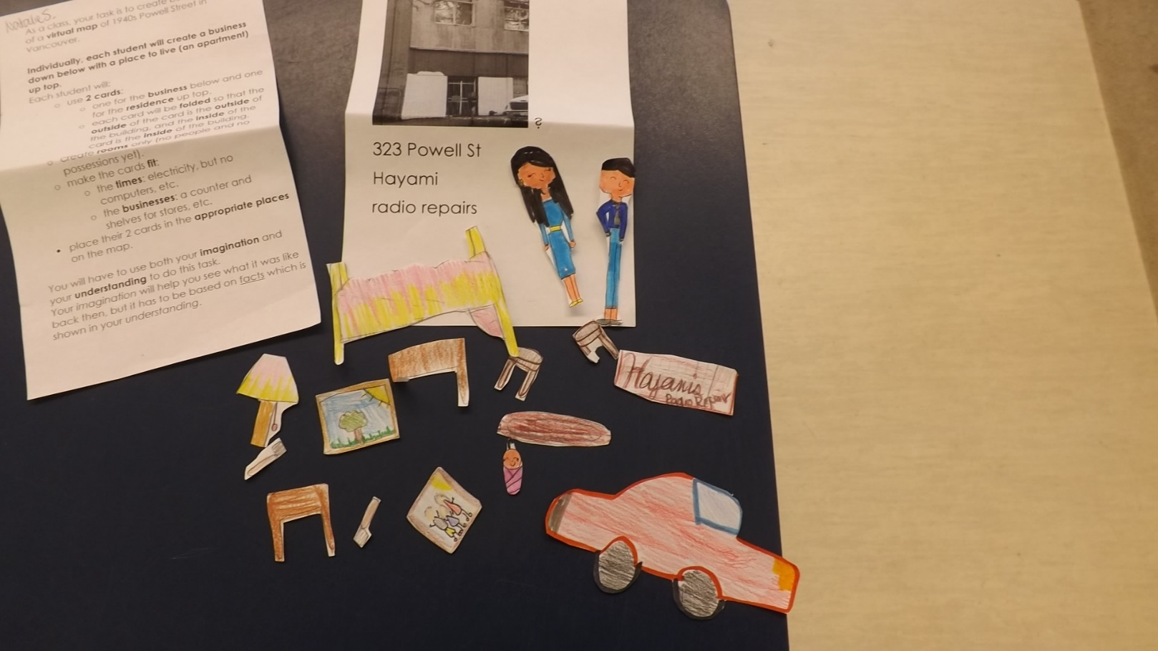
MY SCHOOL: EXAMPLES OF POSSESSIONS, PEOPLE, AND PROPERTY CARD

Slide 15
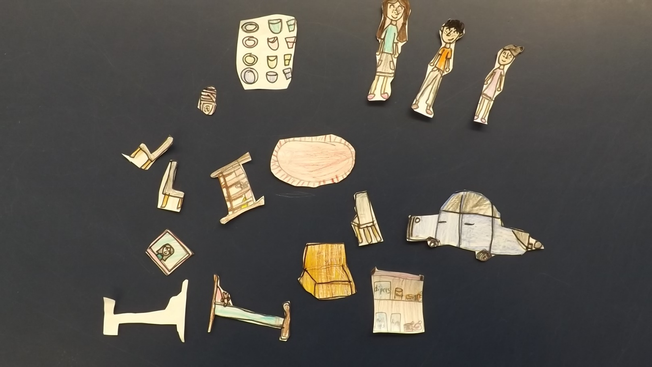
THEY USED THESE TO POPULATE THEIR HOMES AND BUSINESSES.

Slide 16
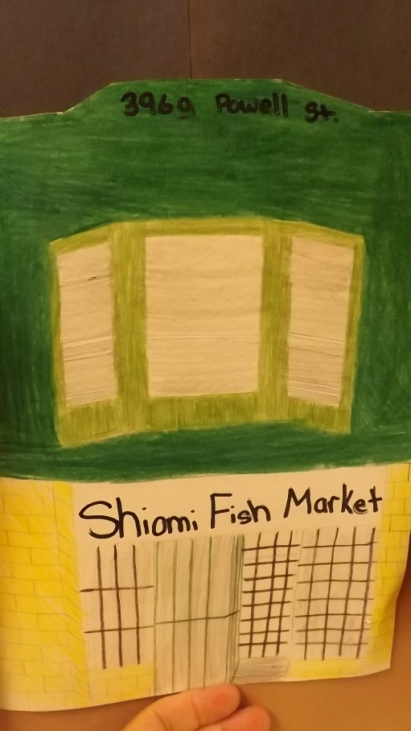
LINDSAY:
EXTERIOR

Slide 17
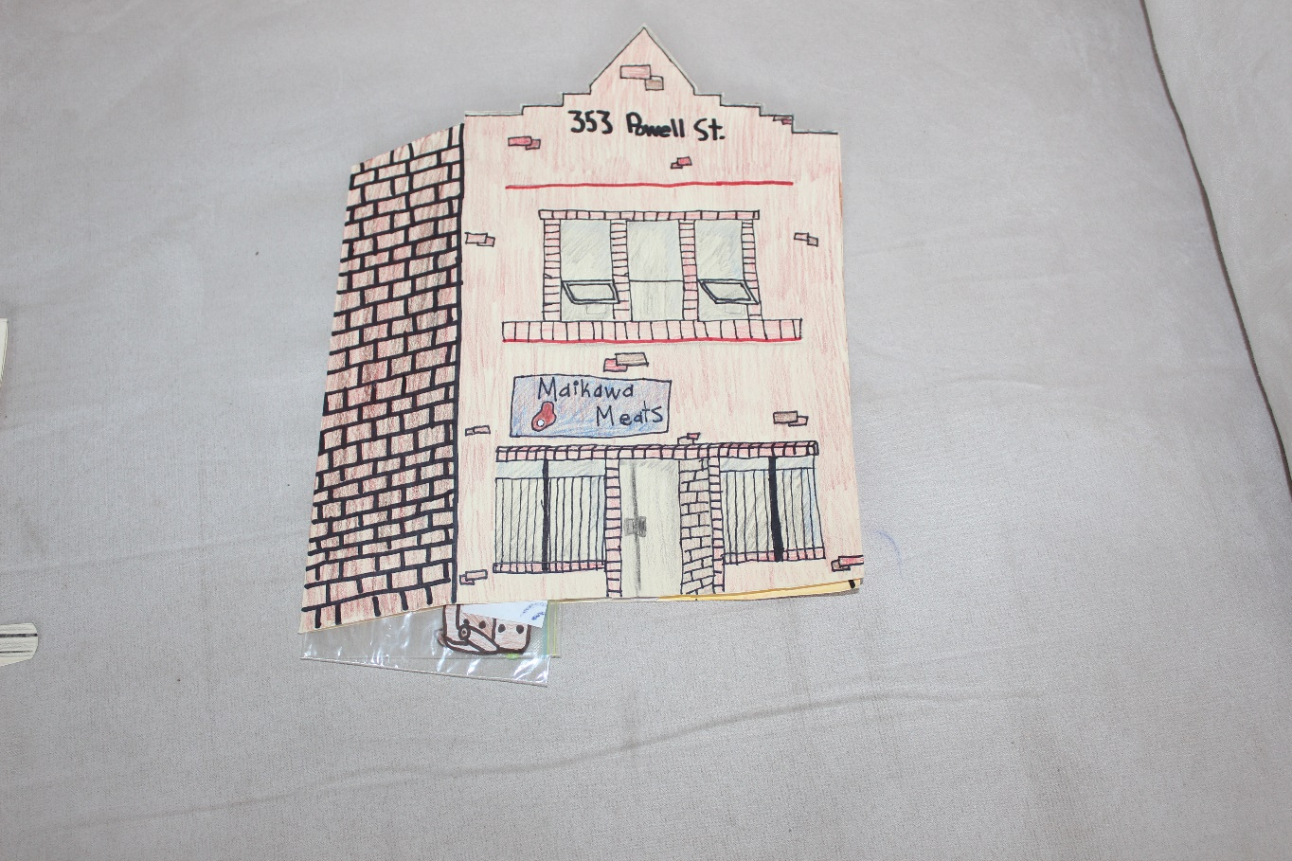
LINDSAY: EXTERIOR

Slide 18
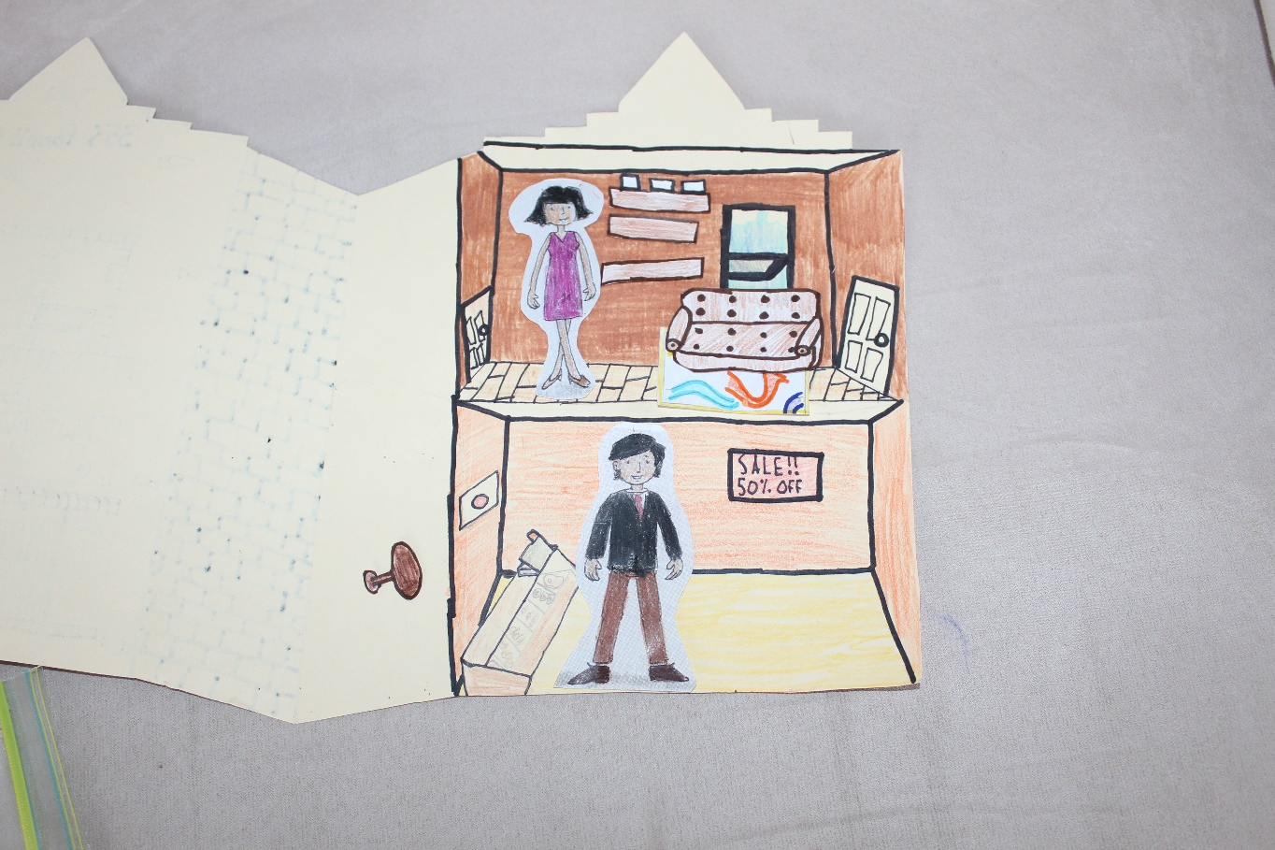
LINDSAY: INTERIOR

Slide 19
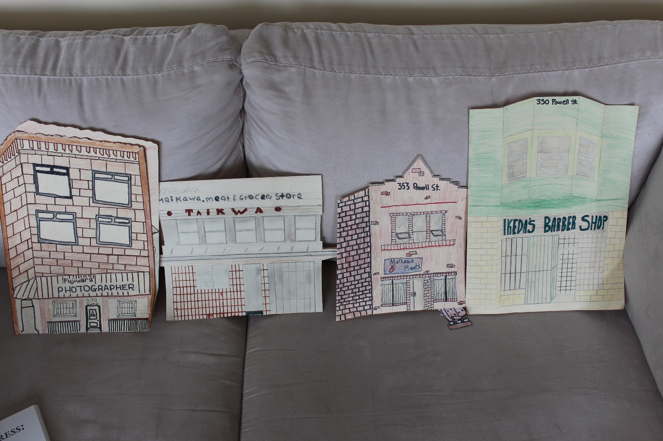
LINDSAY: SAMPLES TAKEN OFF THE BULLETIN BOARD

Slide 20
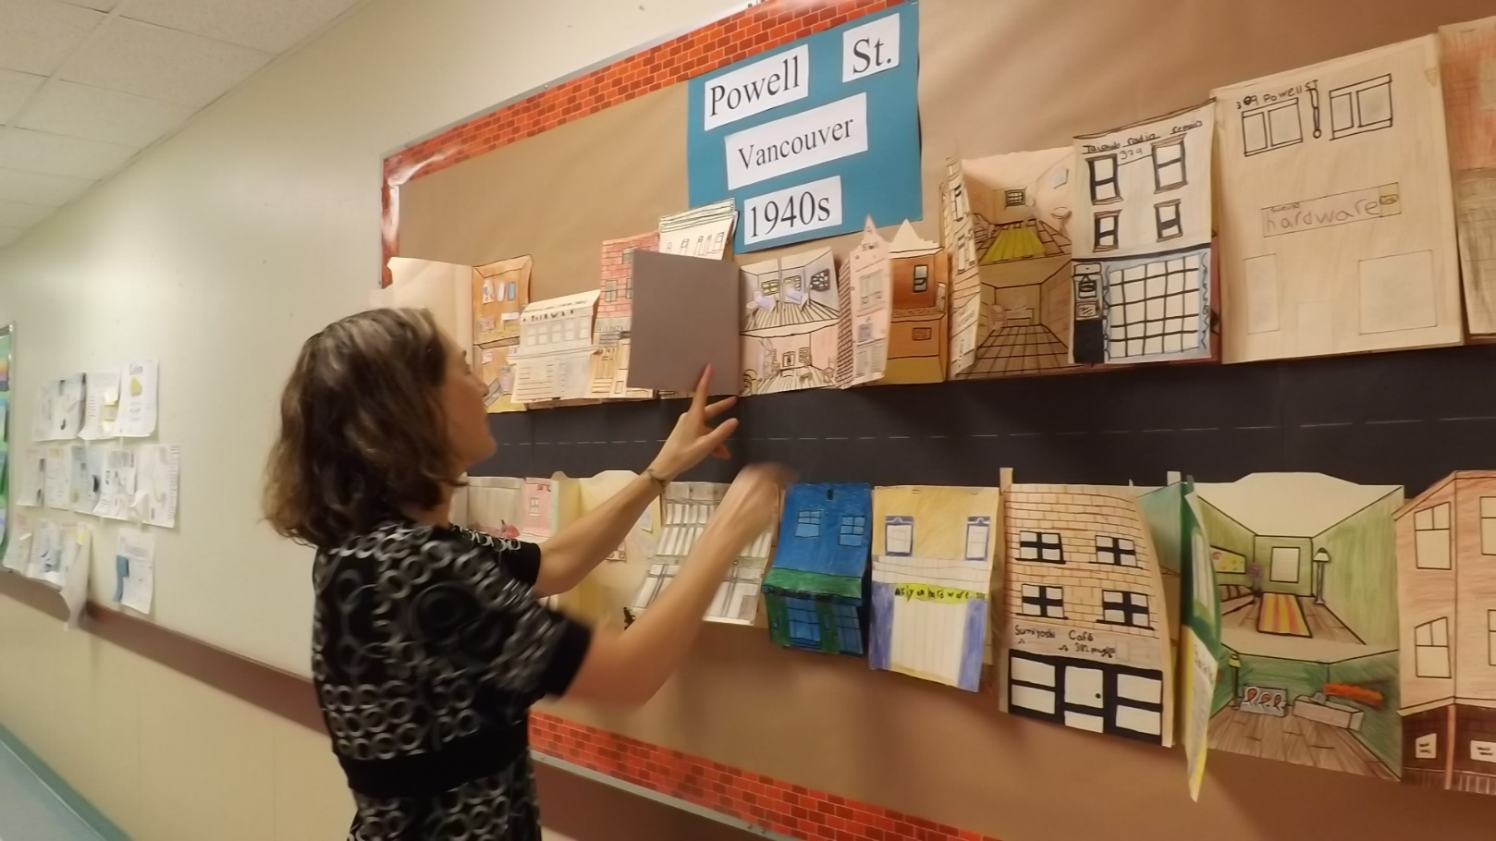
THE STUDENTS DID AN INCREDIBLE JOB INCLUDING DETAIL AND REALISM.

Slide 21
PEARL HARBOUR AND BEGINNING OF INCARCERATION AND FORCED REMOVAL
“People” were moved to camps on a separate bulletin board.
Materials slowly disappeared from Powell Street bulletin board.

Slide 22
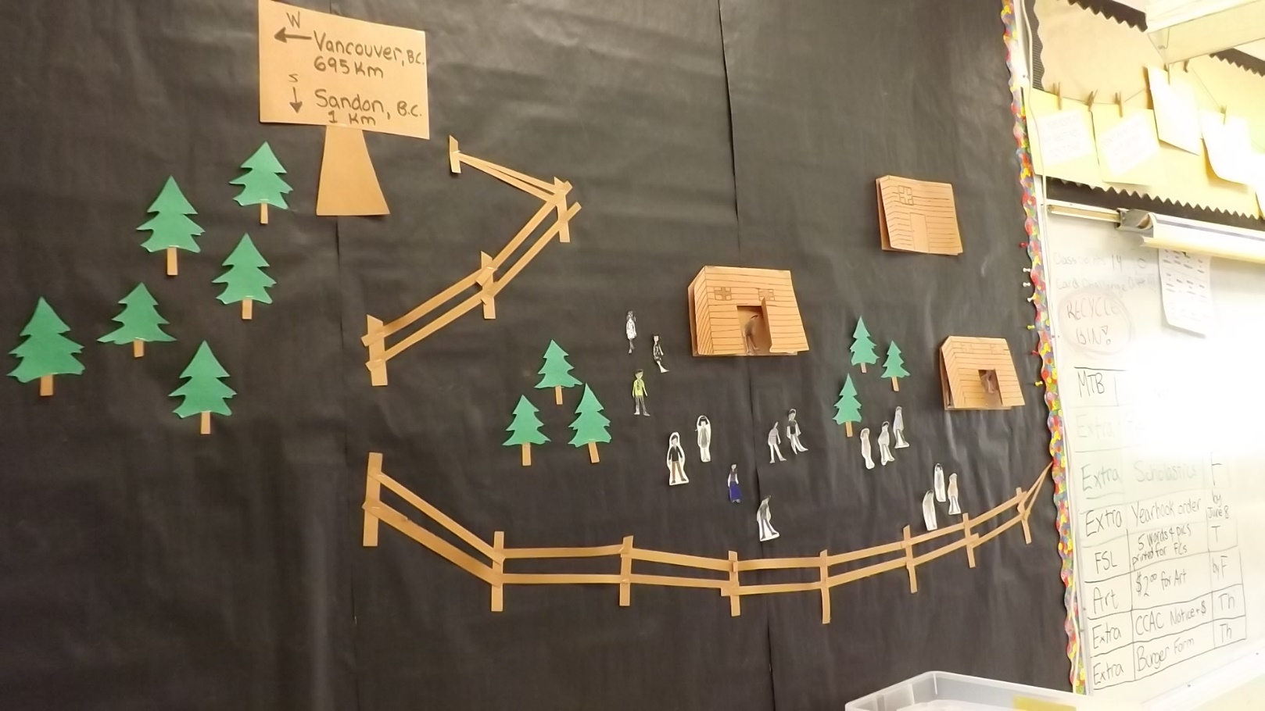
LINDSAY: INTERNMENT CAMP

Slide 23
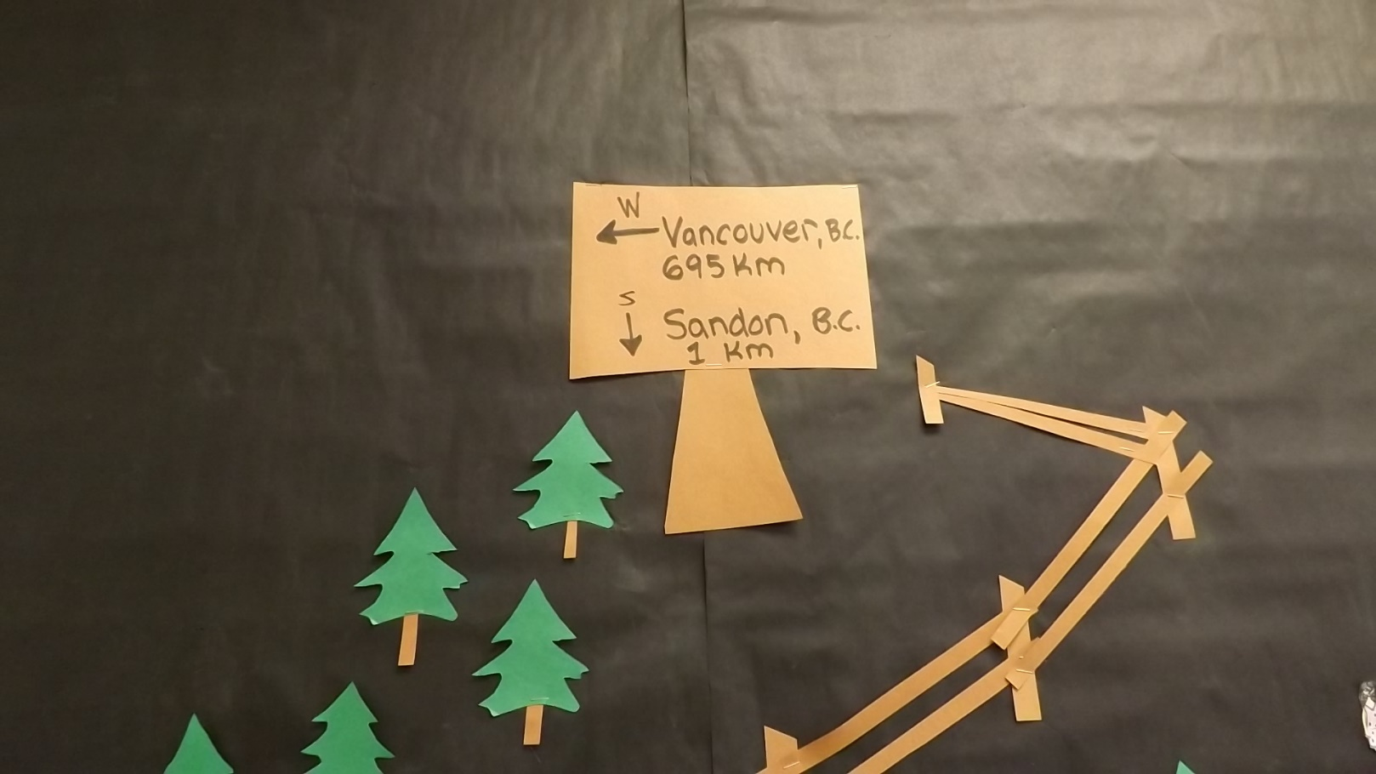
LINDSAY REPORTS THAT THEY STUDENTS WERE REALLY UPSET WHEN THEIR AVATARS WERE MOVED WITHOUT PERMISSION.

Slide 24
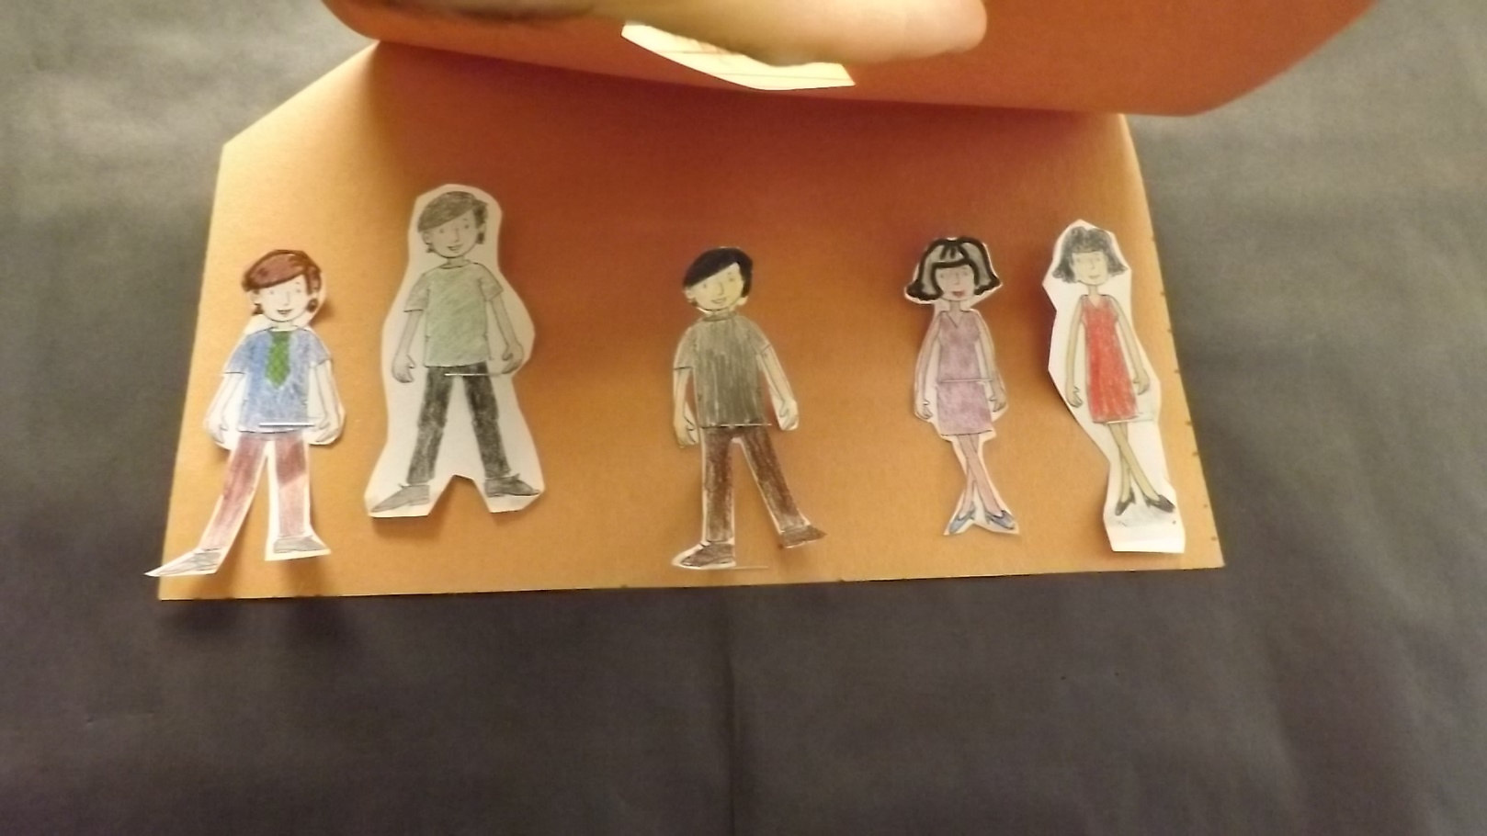
INSIDE SHACK

Slide 25
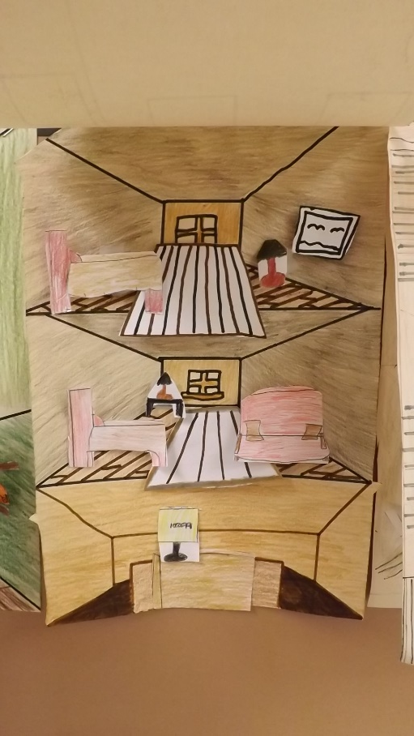
LINDSAY: PEOPLE REMOVED AND POSSESSIONS START TO DISAPPEAR AS THEY ARE SOLD TO PAY FOR INCARCERATION. LINDSAY REPORTS THAT THE STUDENTS WERE EVEN MORE UPSET BY THIS.

